Slide 1

NEPLOY
Designed and Developed By :
Lokeshwaran
Kaushik
Akshat Sachan
Raghavendra K

Slide 2

Project Objective
Simplify NEO Blockchain smart contract development:
Easy Setup: Eliminate environment setup barriers for new developers.
Effortless Workflow: Streamline smart contract coding like WordPress did for websites.
Smooth Deployment: Utilize Kubernetes for seamless compilation, deployment, and testing.
User-Friendly: Provide an intuitive interface for interacting with backend services.
AI-Driven Optimization: Enhance code review with machine learning-based suggestions.
Make NEO smart contract development as intuitive as building a static website.

Slide 3

Solution Approach
The solution mainly focuses and provide the salient features as listed below
Kubernetes to containerize the backend environment, exposing endpoint to the UI.
The frontend is developed using JavaScript, providing a seamless interface for users to interact with the backend's exposed endpoints.
ML model that reviews the smart contract code.
User can leverage and compile smart contract on UI.

Slide 4

Future Neploy Enhancements
Smart Contract Deployment: Simplify deployment on NEO blockchain.
Testing Enhancement: Integrated testing for contracts.
Private Nodes: Simulate controlled network conditions.
Smart Contract Co-Pilot: Real-time coding assistance.
Multi-Language Support: Extend to C#, Java, JS, Golang.

Slide 5

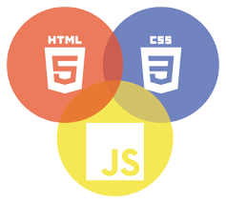
Technology Stack
Machine Learning
Python
JavaScript
CSS
HTML
Dockerfile

Slide 6
THANK YOU
Q & A

